Slide 1
Data Mining Cup 2017 Revenue Forecast of Mail Order Pharmacy
1st intermediate presentation
Data and Web Science Group
University of Mannheim
25.04.2017

Slide 2
DMC 17 - Challenge
In order to predict the revenue we need to
Predict whether a transaction will lead to “order”
Order = 1 vs. Click or Basket = 1
Probability of outcome
Predict the quantity of the ordered product
In order to calculate revenue with the given price

Slide 3
DMC 17 - Challenge
Vorschlag
The provided test set makes it necessary to split the task into two steps:
Predict whether a user action will lead to an order
Order = 1 vs. Click / Basket = 1
Classification problem
Predict the revenue for all “order” actions
Revenue is zero for all examples with Order = 0
Regression problem
!
We want to simplify the regression problem by predicting the sold quantity and not the revenue.

Slide 4

Agenda
Selection
Preprocessing
Transformation
Data Mining
Evaluation & Interpretation
Available data
…….
Target
Data
Preprocessed Data
Transformed Data
Patterns
Adopted from Fayyad et al. (1996)

Slide 5
Preprocessing
Feature Understanding
Domain Knowledge
Feature Generation
Selection
Preprocessing
Transformation
Data Mining
Evaluation & Interpretation
Available data
…….
Target
Data
Preprocessed Data
Transformed Data
Patterns
Adopted from Fayyad et al. (1996)

Slide 6
Feature Understanding

Slide 7
Domain Knowledge
(maybe included in understanding?)

Slide 8
Feature Generation

Slide 9
Transformation, Data Mining, and Evaluation
Time dependent behavior
Baseline
Performance measurement
Selection
Preprocessing
Transformation
Data Mining
Evaluation & Interpretation
Available data
…….
Target
Data
Preprocessed Data
Transformed Data
Patterns
Adopted from Fayyad et al. (1996)

Slide 10
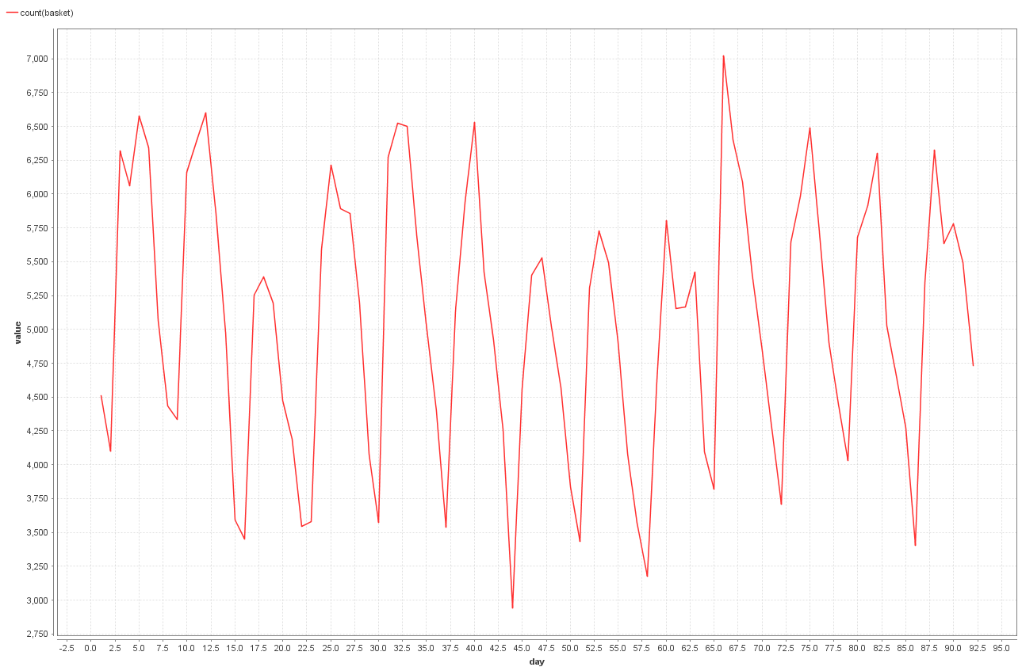
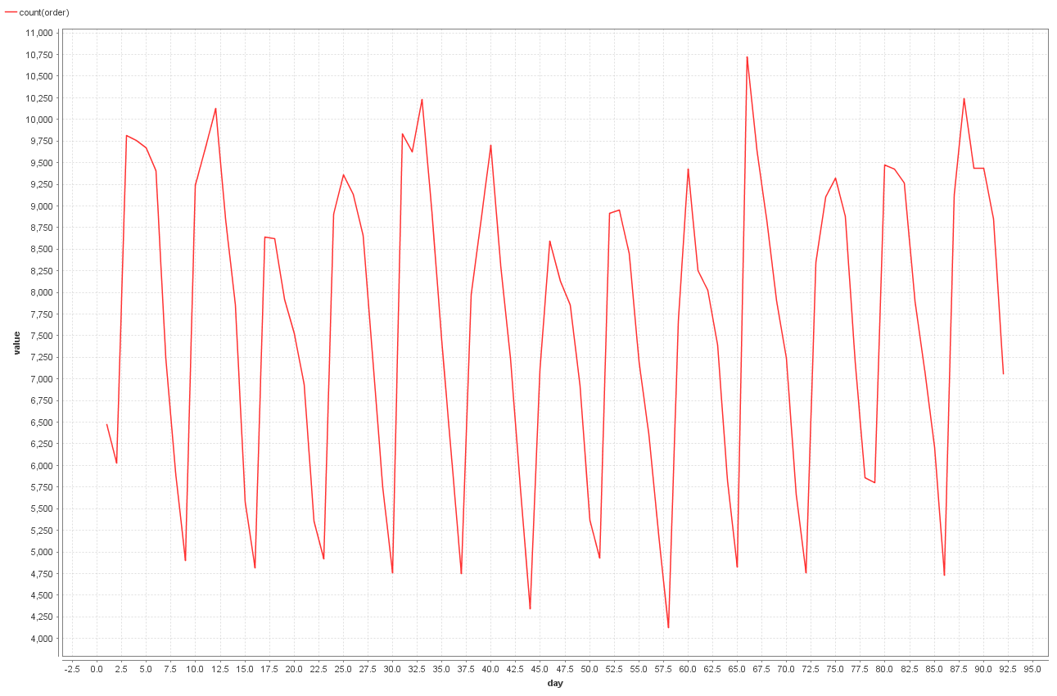
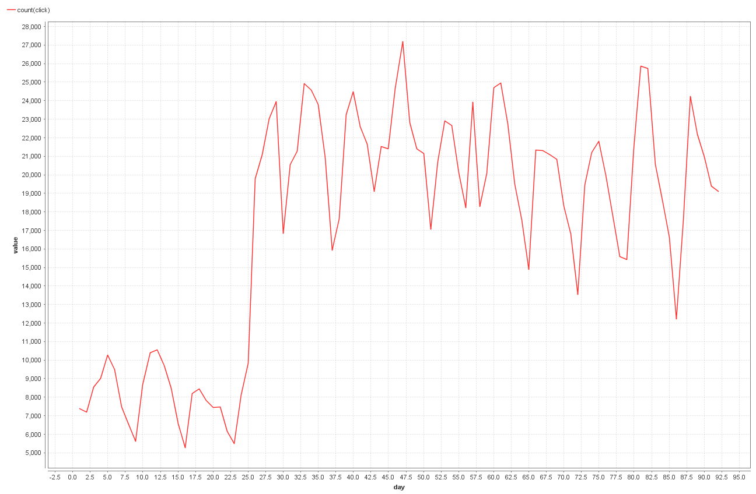
Evaluation of Time Dependent Behavior
Basket actions per day
Order actions per day
Click actions per day
Between day 25 to 26 there is a steep increase (+ 10,000) of clicks
Might be a sign for incomplete data in the first month

Slide 11
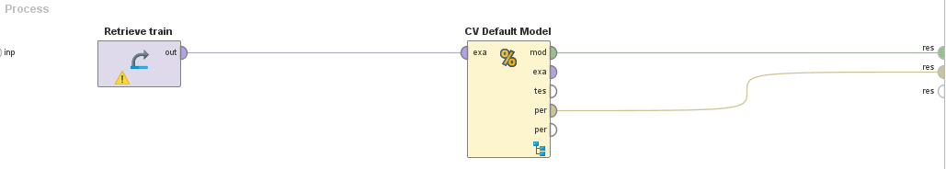
Baseline
Performance of the Default Model
Median: RMSE = 10.904
Average: RMSE = 10.238
For comparison, Gradient Boosted Tree: RMSE = 9.679
*RMSE : Root Mean Squared Error

Slide 12
Performance measurement
Evaluation takes place on transaction level and the difference between actual value and prediction is squared
Crucial to predict
high revenue transactions correctly
High quantity with decent price
High price
Medium high quantity with medium high price
highly frequent transactions correctly
i.e. No revenue flags

Slide 13
Open questions
i.e. Can two items be bought together? …

